Slide 1
Placement Management System
-ABINASH ANKIT RAUT(14CS01012)
-K ANANTH (14CS01018)

Slide 2
Objective
To design a database along with its frontend and backend components to facilitates placements of the institute.

Slide 3
Specifications:
Student Sign-up and Log-in.
Company Log-in . Company sign-up, registration done by database admin(PLO).
History containing yearly company statistics(Avg Package, No of Students Selected).
Everyone can see the Placement History.
Student can register in companies visiting for their passing year which he/she is eligible to.
Student can deregister from company before interview.
Student can change his details(Phone no, email, passing year(on failing-deletes all placement related data)).
Students can view available offers. Can accept only one.
Company can see registered students for the interview.
Company can offer placement to student after interview.
Company can view list of students who accepted the offer and offer acceptance is pending.

Slide 4
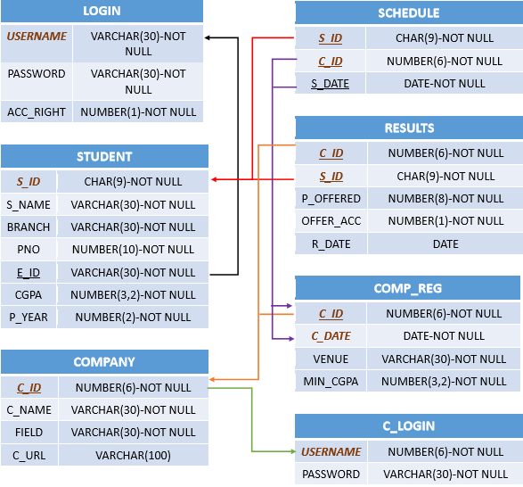
RELATIONAL MODEL

Slide 5
Tools and Triggers details:
FRONTEND TOOLS
BACKEND TOOLS
TRIGGERS USED
HTML
CSS
JAVASCRIPT
JQUERY
MySQL
PHP
COMP_REG_CHECK
SC_CHECK
Min CG Check
Already Acc Check
Valid Comp-Student Check
OFF_ACC_CHECK
OFF_CHECK
DEL_YR_CHG
Comp_id_Check
RES_ACC_CHECK
EVENTS SCHEDULED
DELETE SCHEDULE, COMPANY REGISTRATION AFTER EACH YEAR

Slide 6
DEMONSTRATION
Visit: http://localhost/site/ for demonstration.
Server Used: Xampp (Apache Server)– for locally hosting
Administrator Control Panel: phpmyadmin

Slide 7
CONCLUSION
A full-fledged project has been successfully implemented to ensure smooth functioning of the placements.
Limitations
Unavailability of University database lead to reduction of features.
More secure and consistent student login can be ensured by making student s_id as referential attritute to university database student table.
More company requirements can be added by using university database.

Slide 8
THANK YOU

